Slide 1

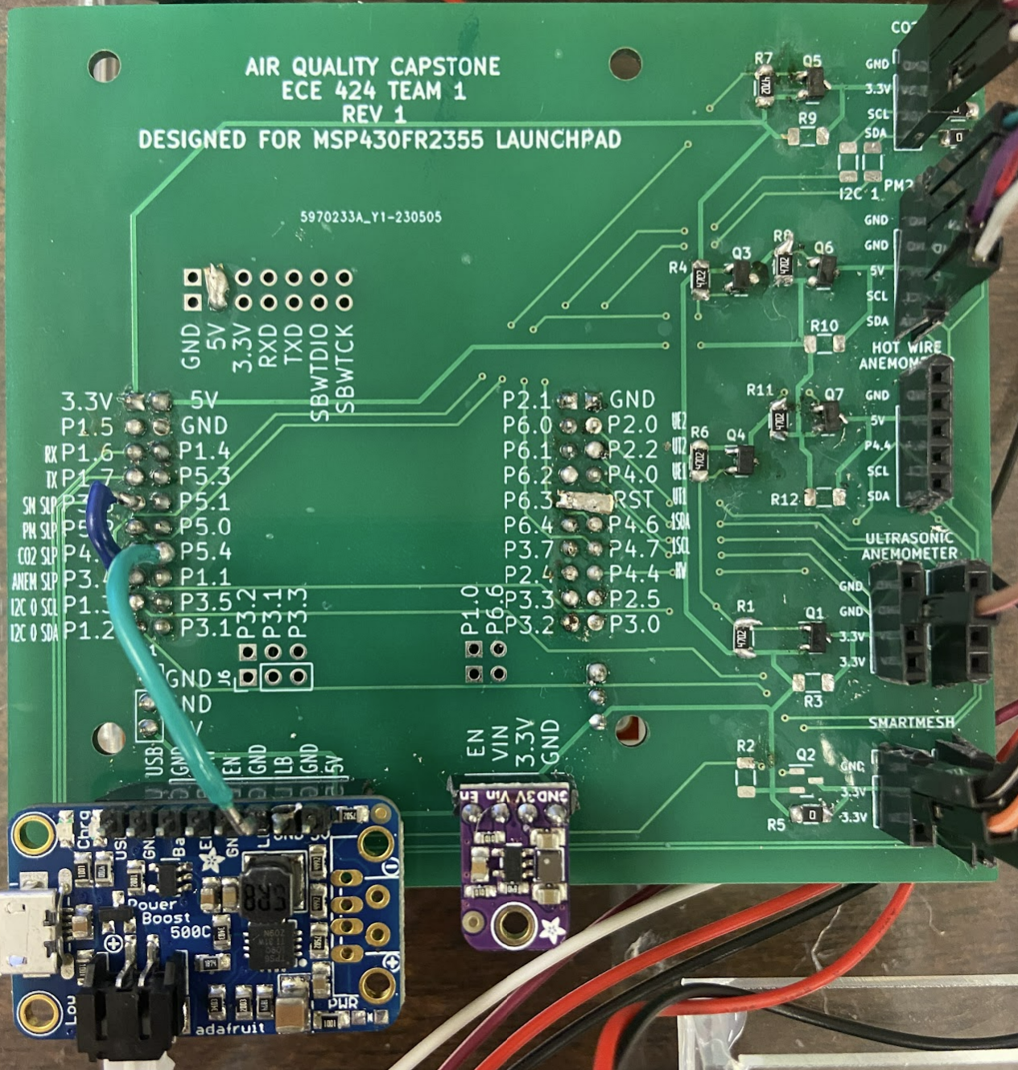
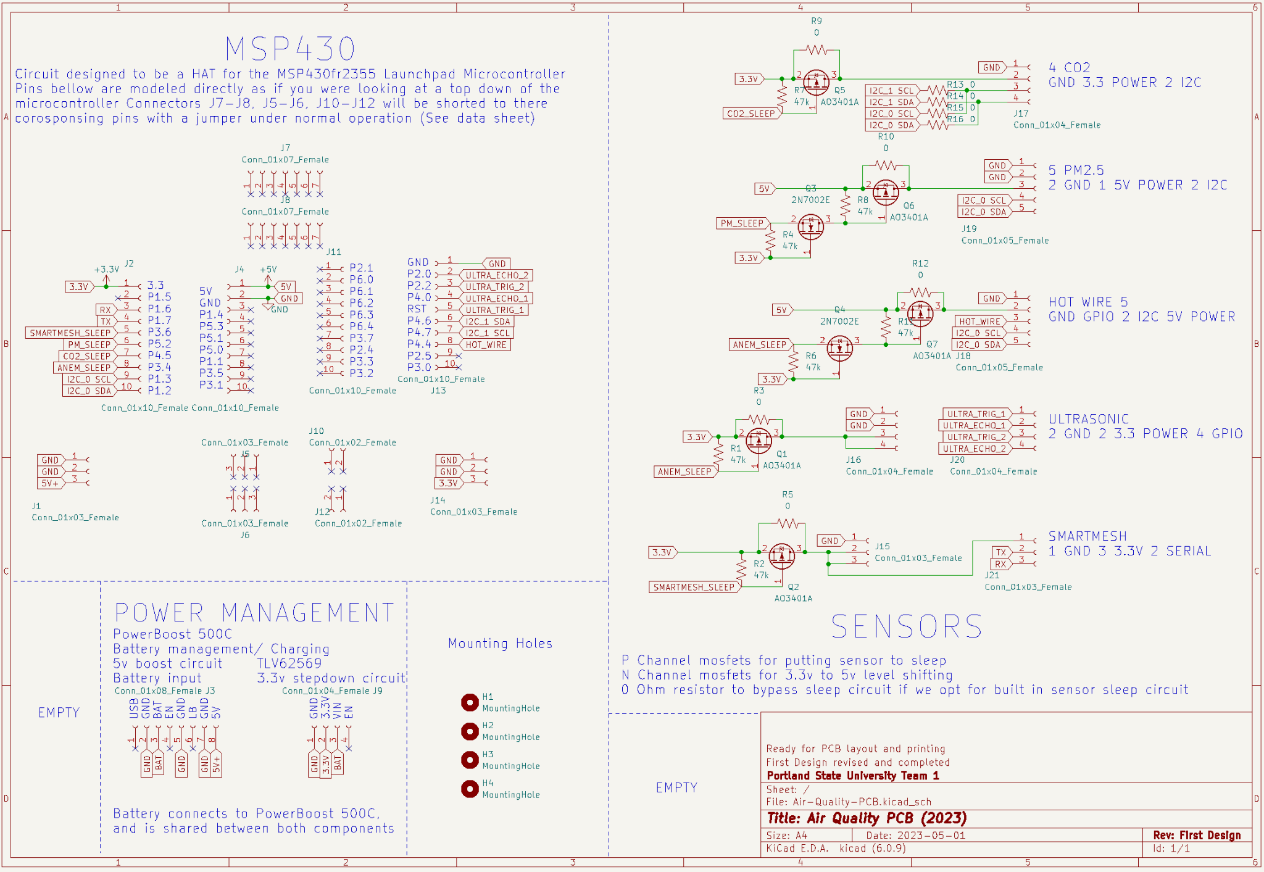
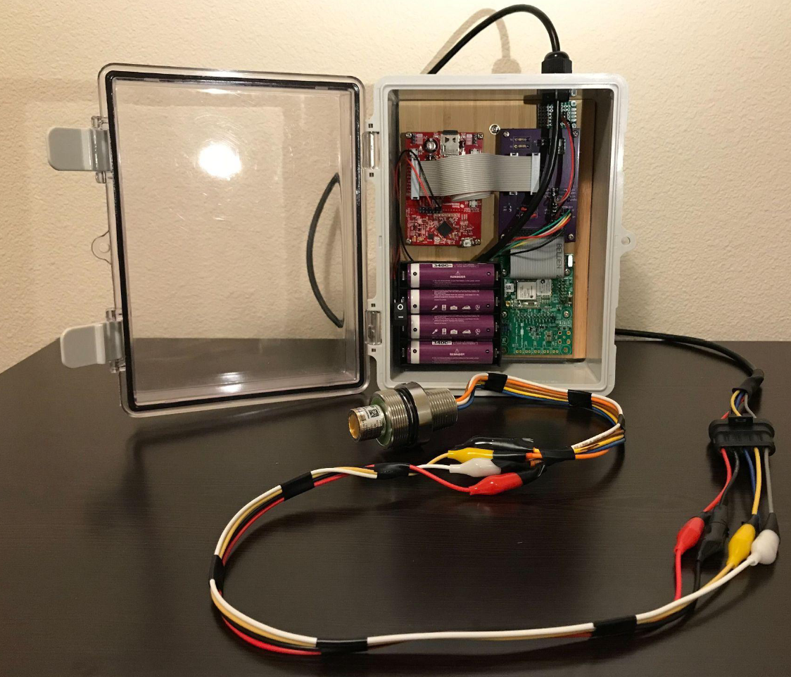
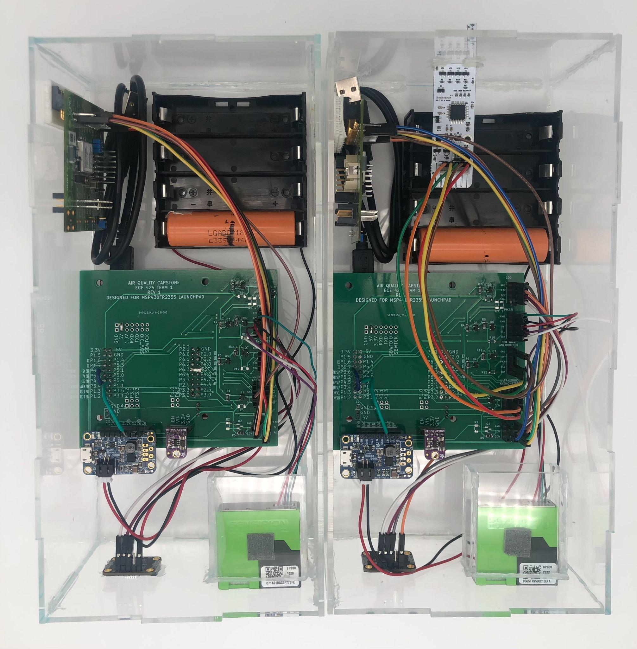
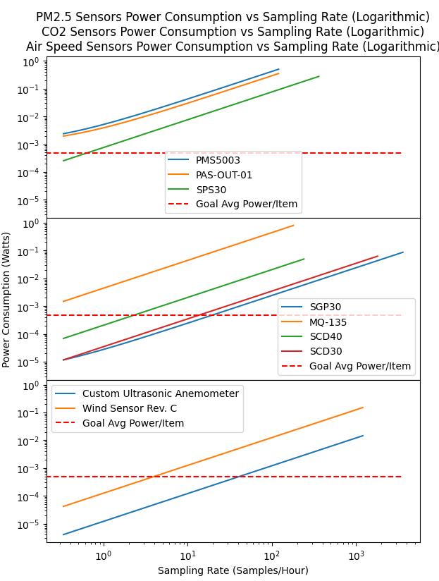
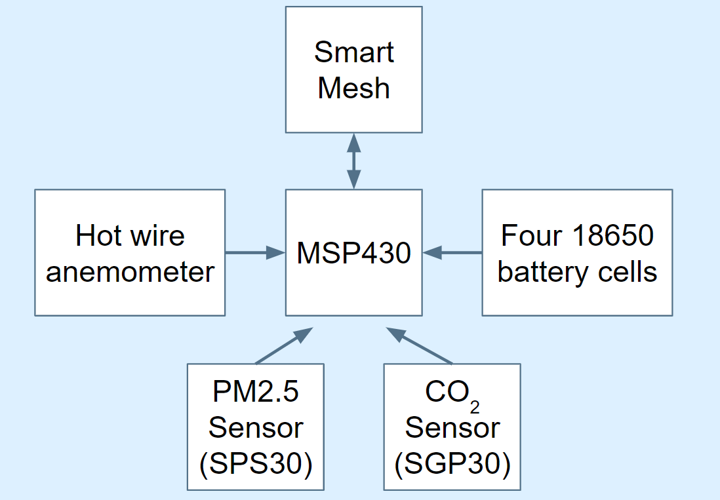
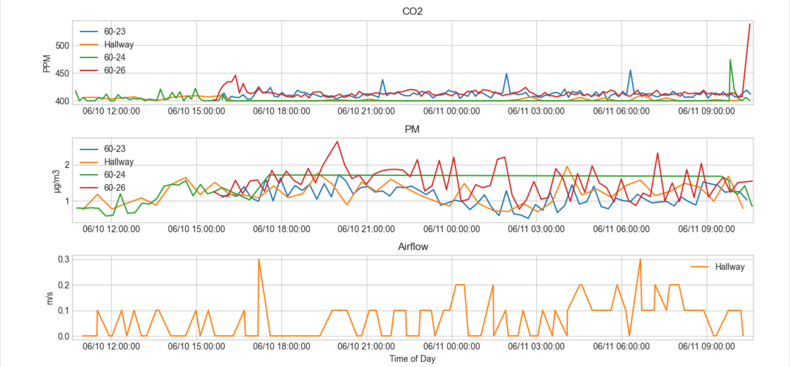
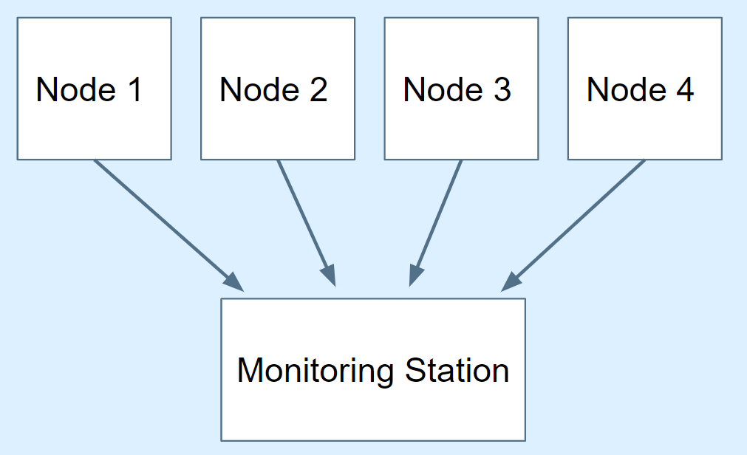


Open-Source Wireless Sensor System For Indoor Air Quality Monitoring
Team: Adam A. Dezay, Manuel A. Garcia, Brandon P. Hippe, Mercedes C. Newton Faculty Advisor: Prof. John M. Acken Industry Sponsor: PSU ECE Dept, WEST Lab (Prof. David C. Burnett)
Objective: Build three to ten wireless, battery powered devices to monitor elevated quantities of CO₂ (Carbon Dioxide) and PM2.5 (Particulate Matter) as well as air speed utilizing commercial off-shelf components and open-source software for easy replication.
Air Quality
Design Implementation
The quality of the air we breathe intimately impacts our health yet is rarely monitored in indoor spaces. The quantity of CO₂ is measured in parts per million (PPM). Any concentration of CO₂ over 1000 PPM is considered harmful. PM2.5 is measured in ug/m³. Any concentration of PM2.5 greater than 12 ug/m³ is considered harmful. Elevated levels of these contaminants can have detrimental effects on our health as well as our ability to focus. Airflow, measured in m/s, can give a sense of how frequently the volume of air in a space gets replaced.
We simplified our design by creating a hat for the MSP430. We made some modifications on top of our final design using jumper wires above and below. Pictured is the adaptation to our boards, however our finalized and published PCB CAD file (shown to the right) has these modifications taken into account. When designing our enclosure it was important to leave ample space between the sensors (placed at the bottom of the enclosure) and the anemometer and battery (placed at the top of the enclosure) in order to ensure heat would not affect our readings. These devices communicate with each other using SmartMesh IP, automatically forming a mesh network of up to 100 devices and covering a wide area.
Pre-Existing Design
Our research and design builds upon the work of previous capstone teams. Last year’s team utilized the MSP430 and SmartMesh technology to record N₂O (Nitrous Oxide), temperature and humidity outdoors. Our team built upon the previous teams knowledge of the MSP430 and SmartMesh technology, this time employing it for an indoor application.
Power Consumption
Final Product
Our modules are battery powered for user ease. Our team estimated the power consumption of each sensor before selecting in order to ensure the longest possible battery life. To the left is a graph that demonstrates the power consumption of each sensor. After sensors were selected, we calculated how frequently we could measure data with each sensor in relation to how long the battery life would then be. The user can adjust how frequently the sensors sample for desired battery life or conditions.
We developed one unit with a hot wire anemometer and three units without anemometers (four total units). Pictured are two of our final nodes, with the anemometer node pictured on the right and a node without the anemometer to its left. Our systems have been set up in various rooms to collect data, shown in the plot below. Our team satisfied all requirements placed by our faculty advisor and industry sponsor and created a product that will hopefully be used at PSU for years to come.
R. Leon, W. Bi, E. Eynis, T. Johnson, W. Yan, J. Acken, and D. C. Burnett, "The Networked Nitrous Node: A Low-Power Field-Deployable COTS-Based N2O Gas Sensor Platform," IEEE Sensors Letters, vol. 7, no. 6, pp. 1–4, Jun. 2023, doi: 10.1109/LSENS.2023.3276339.
Design Overview
Our major focuses when designing this sensor system were creating modules that were power efficient, accurate and affordable. With this in mind we decided to use the Sensirion SPS30 PM2.5 sensor and the Sensirion SGP30 eCO₂ sensor. We attempted to design an ultrasonic anemometer, as it would consume far less power and enable more frequent data collection, but ultimately we were unable to salvage this idea and pivoted to utilizing the ClimateGuard Hot Wire Anemometer. This anemometer consumes a lot of power and also produces a lot of heat, which made implementing it challenging.
diagram of single node
Sensor | 3 Months Battery Life | 6 Months Battery Life | 1 Year Battery Life
CO₂ | 8.5 min (510 sec) | 18 min (1080 sec) | 37 min (2220 sec)
PM2.5 | 16 min (960 sec) | 34 min (2040 sec) | 72 min (4320 sec)
Component Measurement Periods for 3 month, 6 month, and 1 year battery life for units without anemometer
Sensor | 3 Months Battery Life | 6 Months Battery Life | 1 Year Battery Life
CO₂ | 27 min (1620 sec) | 61 min (3660 sec) | 170 min (10200 sec)
PM2.5 | 32 min (1920 sec) | 72 min (4320 sec) | 195 min (11700 sec)
Hot Wire Anemometer | 14 min 38 sec (878 sec) | 33 min (1980 sec) | 90 min 50 sec (5450 sec)
Diagram of meshed node system
Component Measurement Periods for 3 month, 6 month, and 1 year battery life for units with hot wire anemometer
Department of Electrical and Computer Engineering
Visit our website for more information!
https://web.cecs.pdx.edu/~dburnett/capstone2023/
Notes:
This is just a template. Modify it to your heart’s content, and especially modify it if sections do or don’t apply to your capstone! This poster is about telling the story of your capstone - what were you asked to do, what did you come up with, what did you do, and how did it go?

